Slide 1
AI-Based Eye Tracking System
Module: MediaPipe & Its Function

Slide 2
Introduction to MediaPipe
MediaPipe is an open-source framework by Google
Used for real-time computer vision applications
Provides pre-trained ML models for:
Face detection
Hand tracking
Pose estimation
Works efficiently on normal CPUs

Slide 3
Why MediaPipe in This Project
Real-time facial landmark detection
Works with standard RGB camera (no IR needed)
Lightweight and fast
High accuracy for eye & iris tracking
Suitable for assistive systems for disabled users

Slide 4
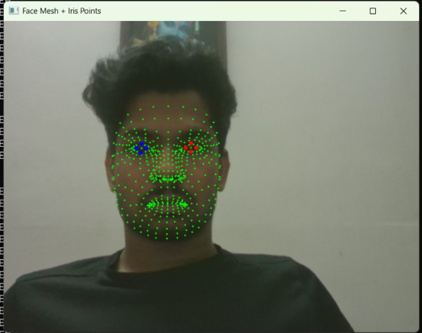
Face Mesh & Landmark Detection
Detects 468 facial landmarks
Extracts:
Eye corners
Eyelids
Iris points
Robust to lighting changes & small head movement

Slide 5
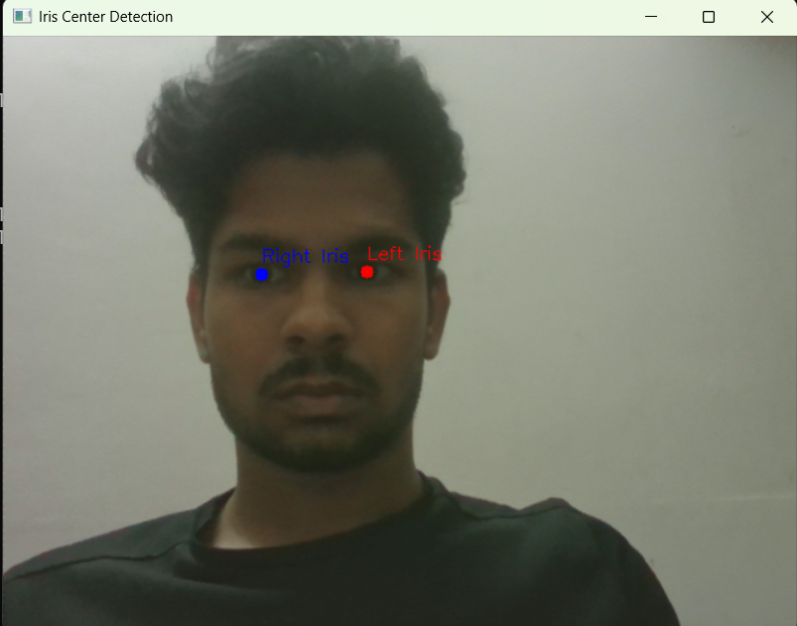
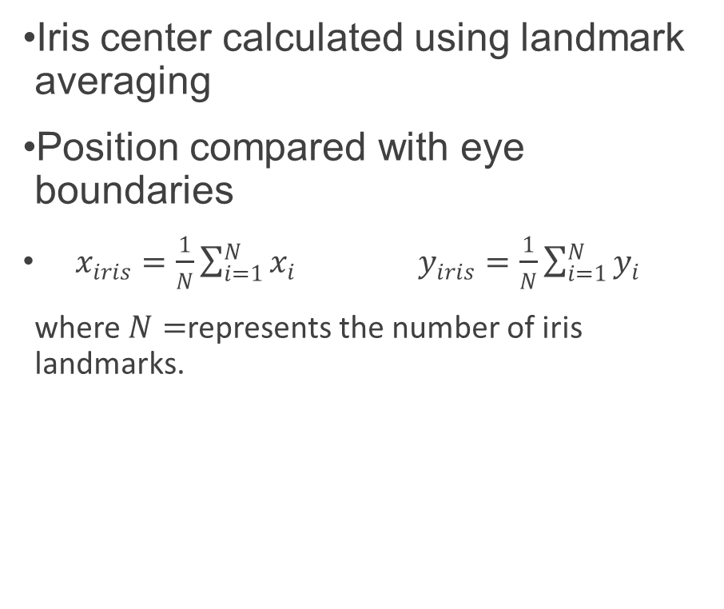
Iris Tracking
Iris center calculated using landmark averaging
Position compared with eye boundaries
$\begin{matrix} & x_{iris}=\frac{1}{N}\sum_{i=1}^{N}{x_{i}} & & \end{matrix}\begin{matrix} & y_{iris}=\frac{1}{N}\sum_{i=1}^{N}{y_{i}} & & \end{matrix}$
where $N=$represents the number of iris landmarks.

Slide 6
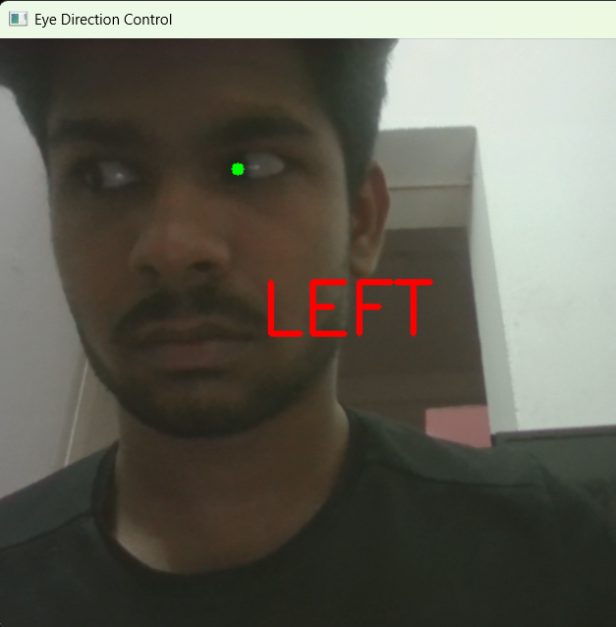
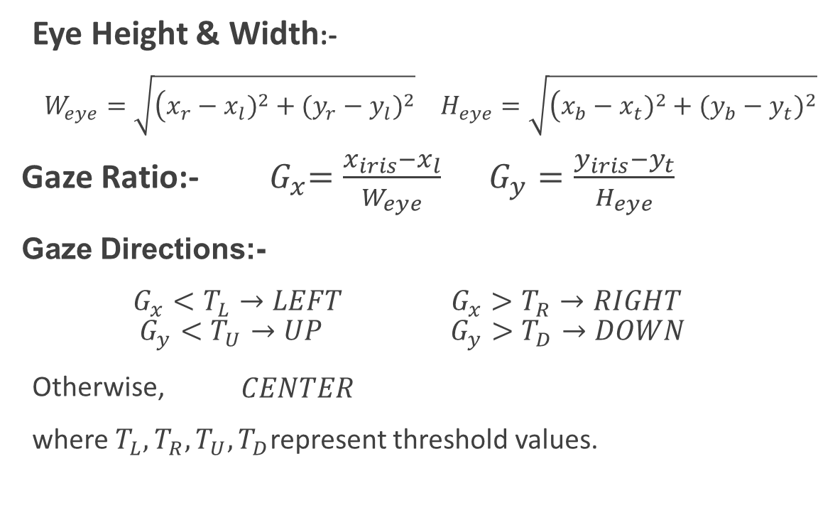
Gaze Estimation
Eye Height & Width:-
$W_{eye}=\sqrt{\left(x_{r}−x_{l})^{2}+(y_{r}−y_{l})^{2}\right.}$ $H_{eye}=\sqrt{\left(x_{b}−x_{t})^{2}+(y_{b}−y_{t})^{2}\right.}$
Gaze Ratio:-${ G}_{x}=\frac{x_{iris}−x_{l}}{W_{eye}}$ $G_{y}=\frac{y_{iris}−y_{t}}{H_{eye}}$
Gaze Directions:-
$\begin{matrix} & G_{x}<T_{L}→LEFT & & \end{matrix}\begin{matrix} & G_{x}>T_{R}→RIGHT & & \end{matrix}$ $\begin{matrix} & G_{y}<T_{U}→UP & & \end{matrix}\begin{matrix} & G_{y}>T_{D}→DOWN & & \end{matrix}$
Otherwise, $\begin{matrix} & CENTER & & \end{matrix}$
where $T_{L},T_{R},T_{U},T_{D}$represent threshold values.

Slide 7
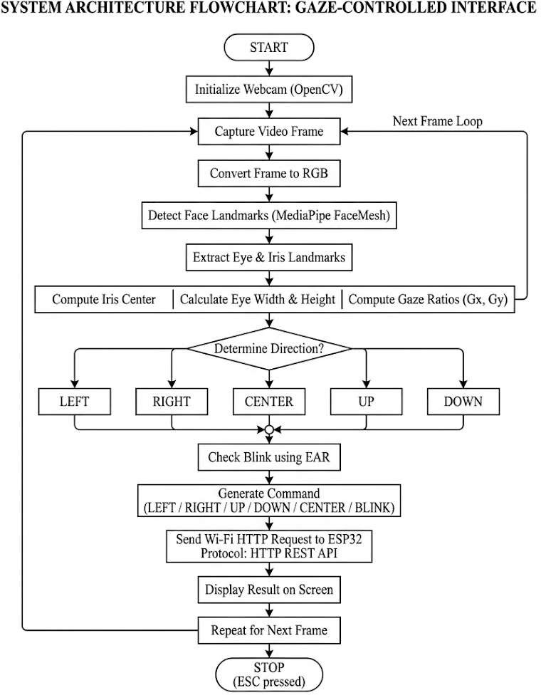
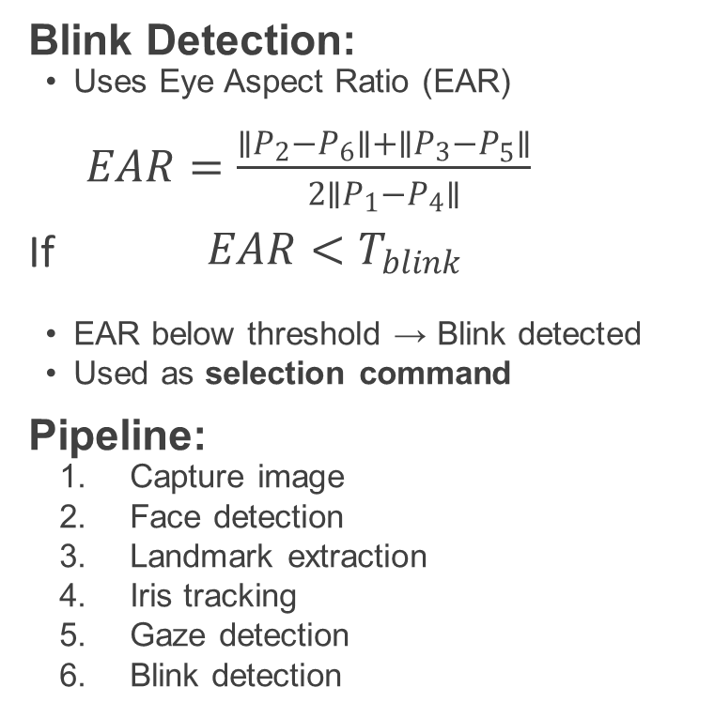
Blink Detection & Processing Pipeline
Blink Detection:
Uses Eye Aspect Ratio (EAR)
$\begin{matrix} & EAR=\frac{∥P_{2}−P_{6}∥+∥P_{3}−P_{5}∥}{2∥P_{1}−P_{4}∥} & & \end{matrix}$
If $\begin{matrix} & EAR<T_{blink} & & \end{matrix}$
EAR below threshold → Blink detected
Used as selection command
Pipeline:
Capture image
Face detection
Landmark extraction
Iris tracking
Gaze detection
Blink detection

Slide 9
Role, Advantages & Limitations
Role:
Converts eye movement → control signals
Sends commands to microcontroller
Advantages:
Real-time & accurate No special hardware Low-cost solution
Limitations:
Sensitive to lighting Issues with glasses/occlusion Reduced accuracy with large head movement

